Slide 1
Chapter 4
Brain, Perception, and Motor Development
Notes:
Add slide notes here

Slide 2
Foundations of Brain Development (1 of 3)
Neurons: cells that make up the brain
  Communicate with other cells and make it possible for people to sense the world, think, move their body, and carry out their lives
Notes:
Learning Objective: 4-1: Describe the parts of the neuron and brain and the role of experience in brain development.
I. Foundations of Brain Development
A. Neurons: cells that make up the brain that have special structures that enable them to communicate with other cells to make it possible for people to sense the world, think, move their body, and carry out their lives
B. The Neuron
a. Dendrites: branching receptors that receive neurotransmitters from other neurons that are converted into electrical signals
b. Neurotransmitters: chemical messages passed between neurons
c. Axon: long tube-like structure that extends from the neuron and carries
electrical signals to other neurons
d. Synapse: the gap in between neurons
e. Myelin: the fatty substance that coats axons that speeds the transmission of
electrical impulses and neurological function
f. Neurogenesis: the process in which the first neurons form in early prenatal
development in the embryo’s neural tube
g. Glial cells: a second type of brain cell that nourish neurons and move
throughout the brain to provide a physical structure to the brain

Slide 3
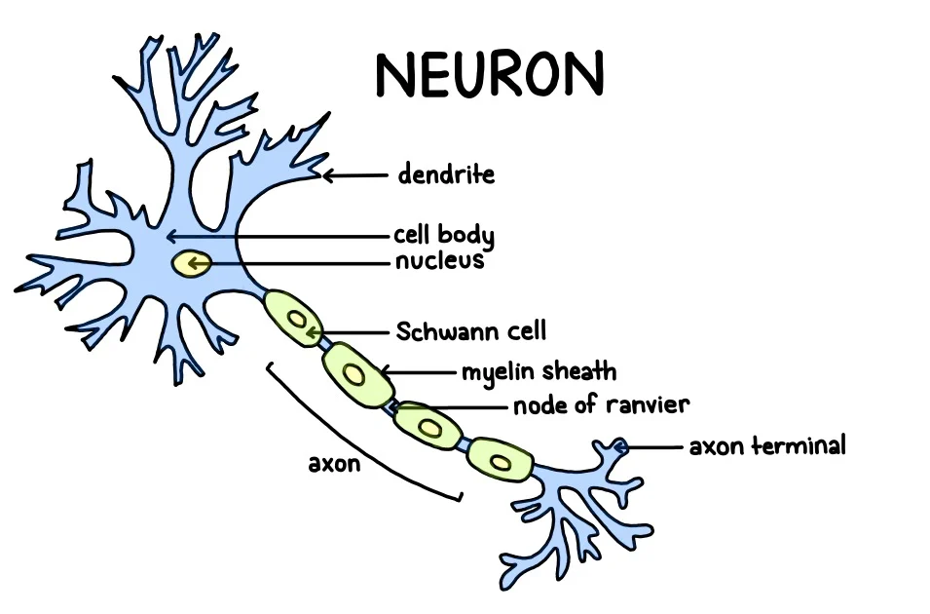
Notes:
Learning Objective: 4-1: Describe the parts of the neuron and brain and the role of experience in brain development.
I. Foundations of Brain Development
A. Neurons: cells that make up the brain that have special structures that enable them to communicate with other cells to make it possible for people to sense the world, think, move their body, and carry out their lives
B. The Neuron
a. Dendrites: branching receptors that receive neurotransmitters from other neurons that are converted into electrical signals
b. Neurotransmitters: chemical messages passed between neurons
c. Axon: long tube-like structure that extends from the neuron and carries
electrical signals to other neurons
d. Synapse: the gap in between neurons
e. Myelin: the fatty substance that coats axons that speeds the transmission of
electrical impulses and neurological function
f. Neurogenesis: the process in which the first neurons form in early prenatal
development in the embryo’s neural tube
g. Glial cells: a second type of brain cell that nourish neurons and move
throughout the brain to provide a physical structure to the brain

Slide 4
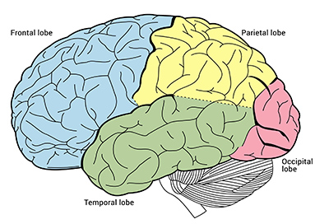
Foundations of Brain Development (2 of 3)
The Cerebral Cortex
Cortex: brain’s wrinkled and folded outermost layer that composes about 85% of the brain’s mass and is comprised of four lobes
  Frontal lobes
  Temporal lobe
  Parietal lobe
  Occipital lobe
Notes:
Learning Objective: 4-1: Describe the parts of the neuron and brain and the role of experience in brain development.
C. The Cerebral Cortex
a. Cortex: the brain’s wrinkled and folded outermost layer that composes about 85% of the brain’s mass and is comprised of four lobes
i. Frontal lobes—involved in complex thought, planning, movement, language, and impulse control
ii. Temporal lobe—processes auditory information and plays a role in language and memory
iii. Parietal lobe—integrates sensory input, spatial location, and plays a role in motor control
iv. Occipital lobe—processes vision
b. Prefrontal cortex: the part of the frontal lobe that is responsible for executive function (planning, goal setting, controlling impulses) and using cognitive skills and memory to solve problems; develops throughout infancy, childhood, and adolescence and matures into early adulthood

Slide 5
Foundations of Brain Development (3 of 3 )
Experience and Brain Development
Sensitive period: optimal time for development in which individuals are particularly vulnerable to environmental factors (infancy)
Experience-expectant brain development: brain’s dependence on experiencing certain basic events and stimuli at key points in time to develop normally
Experience-dependent brain development: brain’s growth that occurs in response to learning experiences
Notes:
Learning Objective: 4-1: Describe the parts of the neuron and brain and the role of experience in brain development.
D. Experience and Brain Development
a. Sensitive Period: an optimal time for development in which individuals are particularly vulnerable to environmental factors (infancy)
b. Experience-Expectant Brain Development
i. Experience-expectant brain development: the brain’s dependence on experiencing certain basic events and stimuli (e.g., hearing language, seeing the world, touching objects, and exploring the environment) at key points in time to develop normally
ii. Demonstrated with sensory deprivation research with animals
c. Experience-Dependent Brain Development
i. Experience-dependent brain development: the brain’s growth that occurs in response to learning experiences (e.g., learning to stack blocks or crawl on a slippery floor)
ii. Exposure to enriching experiences can enhance children’s development

Slide 6
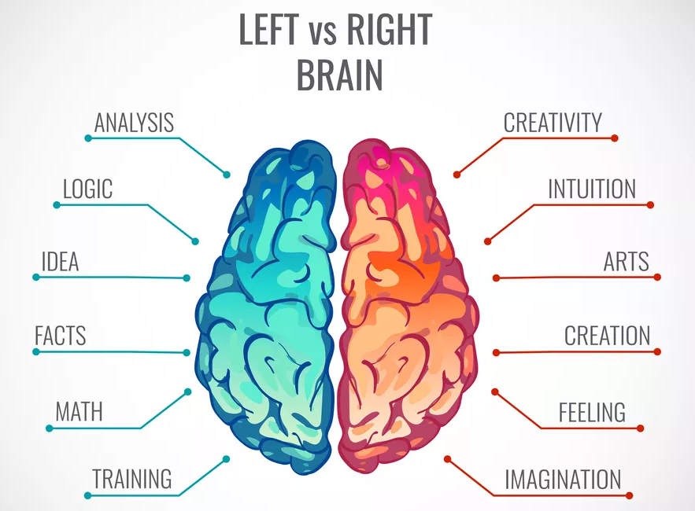
Left-Brain vs. Right Brain (1 of 2)
Left-side associated w/ logic, numbers, detail, etc.
Right-side associated w/ language, creativity, free-thinking, etc.
Left vs right brained?

Slide 7
Left-Brain vs. Right Brain (2 of 2)
Some brain functions are localized to one side of the brain
  Evidence: MRIs, stroke patients, etc.
But do some people favor one side of brain over other?
  No evidence whatsoever
  No differences in brain activity patterns based on personality

Slide 8
Brain Lateralization
Lateralization:
  Asymmetry and specialization of functions
  Left hemisphere controls right side of the body.
    Involved with sequential (step by step) processing for analytic reasoning (math and logic) and language processing (comprehension)
  Right hemisphere controls left side of the body.
    Simultaneous processing for spatial and visual–motor information and emotional content (creativity, empathy, etc.)
  Both hemispheres are used together!

Slide 9
Brain Development in Infancy
Synaptogenesis: dendrites grow and branch out, increasing synapses with other neurons
Synaptic pruning: loss of unused neural connections which can improve the efficiency of neural communication
Myelination: glial cells produce and coat the axons of neurons with fatty myelin which contributes to advances in neural communication
Notes:
Learning Objective: 4-2: Summarize patterns of brain development from infancy through late adulthood.
II. Brain Development
A. Brain Development in Infancy
a. Synaptogenesis: a process in which dendrites grow and branch out, increasing synapses with other neurons
b. Most active areas of synaptogenesis during the first 5 weeks of life are the sensorimotor cortex and subcortical parts of the brain (respiration and other essential survival processes)
c. Synaptic pruning: the loss of unused neural connections which can
improve the efficiency of neural communication by removing “clutter”—excess unused connections
d. Myelination: the process in which glial cells produce and coat the axons of
neurons with fatty myelin which contributes to advances in neural communication
e. Myelination proceeds most rapidly from birth to age 4

Slide 10
Brain Development in Infancy
Developing brain has plasticity:
  Ability to bounce back after trauma
  Better in infancy/ early childhood vs. adolescence/adulthood
  Why?
    Brain is still forming connections in childhood!
    Can more easily “rewire” itself to account for damage
Notes:
Learning Objective: 4-2: Summarize patterns of brain development from infancy through late adulthood.
II. Brain Development
A. Brain Development in Infancy
a. Synaptogenesis: a process in which dendrites grow and branch out, increasing synapses with other neurons
b. Most active areas of synaptogenesis during the first 5 weeks of life are the sensorimotor cortex and subcortical parts of the brain (respiration and other essential survival processes)
c. Synaptic pruning: the loss of unused neural connections which can
improve the efficiency of neural communication by removing “clutter”—excess unused connections
d. Myelination: the process in which glial cells produce and coat the axons of
neurons with fatty myelin which contributes to advances in neural communication
e. Myelination proceeds most rapidly from birth to age 4

Slide 11
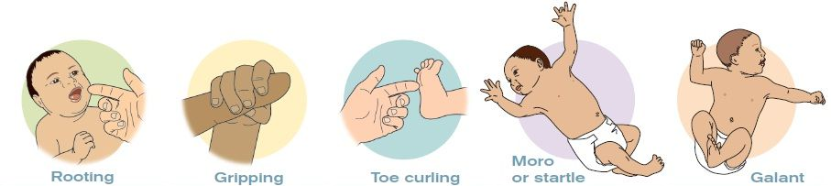
Motor Development (1 of 2)
Reflexes: involuntary and automatic responses to stimuli such as touch, light, and sound
https://www.youtube.com/watch?v=0vrdkzOnGgo
Notes:
Learning Objective: 4-3: Outline patterns of gross and fine motor development across the life span.
III. Motor Development
A. Newborn Reflexes
a. Reflexes: involuntary and automatic responses to stimuli such as touch, light, and sound
b. Infants show individual differences in how reflexes are displayed,
specifically the intensity of the response

Slide 12
Motor Development (2 of 2)
Gross Motor Development: ability to control the large movements of the body
Fine Motor Development: ability to control small movements of the fingers such as reaching and grasping
Notes:
Learning Objective: 4-3: Outline patterns of gross and fine motor development across the life span.
C. Fine Motor Development
a. Fine motor development: the ability to control small movements of the fingers (e.g., reaching and grasping)
b. Infancy
i. Prereaching—infants’ initial fine motor skills that involve swinging their arms and extending them toward nearby objects
ii. As infants reach and acquire objects, they learn by exploring and playing with those objects
c. Childhood
i. As children’s fine motor skills develop, they become more independent
ii. Older children show advances in fine motor control that enable them to develop new interests
d. Adulthood—little research on fine motor aging, but handwriting could be
a helpful diagnostic tool

Slide 13
Sensation, Perception, and Action
Sensation: The process by which sensory receptor neurons detect information and transmit it to the brain
Perception: The interpretation of sensory input
Action: Motor activities prompted by sensory and/or perceptual information

Slide 14
Perspectives on Perception (1 of 2)
Constructivists: Perceptions are constructed through learning.
  We make sense of our environment through our experiences
Nativists: Perception does not require any interpretation
  Everything is inborn (based on biological maturation, drives, etc.)

Slide 15
Perspectives on Perception (2 of 2)
Gibson’s ecological theory of perception:
  Nature–nurture are inseparable.
  Proposes that information important for perception is readily and directly available in the environment
  Perception drives action!
  Affordances!

Slide 16
Vision (1 of 4)
How does vision work?
  Eye takes in stimulation in the form of light.
  Converts it to electrochemical signals to the brain
From the first minutes of life, a newborn can:
  Detect changes in brightness.
  Visually track a slow-moving picture or object.

Slide 17
Vision (2 of 4)
Visual acuity:
  Ability to perceive detail
    At birth, visual acuity is 40 times worse than adult, improves to 20/120 in first month.
Visual accommodation:
  Ability of the lens of the eye to change shape to bring objects at different distances into focus

Slide 18
Vision (3 of 4)
Color vision is present at birth.
  By 4–6 months, color vision is mature.
Newborns can:
  Perceive light and dark.
  Focus on nearby objects.
  See simple patterns.

Slide 19
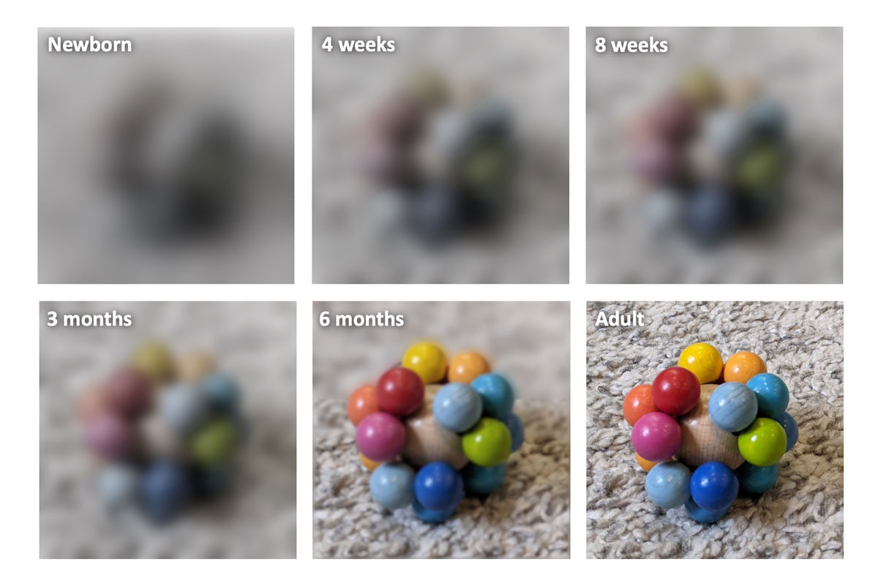
Vision (3 of 4)

Slide 20
Vision (4 of 4)
What are the properties of patterns that capture the young infant’s attention?
  Patterns that have a large amount of light-dark transition, or contour
  Displays that are dynamic (as opposed to static) or contain movement
  Patterns that are moderately complex
Infants perceive faces by 3–5 months of age.

Slide 21
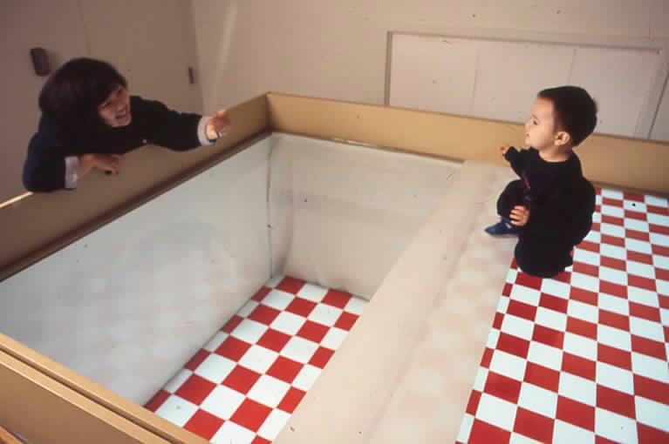
Depth Perception (1 of 2)
Notes:
6-week-olds react with interest to differences in depth (heart rate deceleration).
By 7 months, they show more fear than interest at the cliff’s deep end (heart rate acceleration and refusal to cross the deep side).
Fear of depth seems to develop around the time babies can crawl.

Slide 22
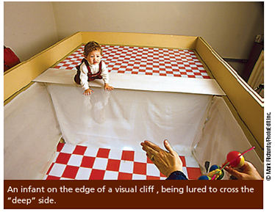
Depth Perception (2 of 2)
Visual cliff experiment:
  Most infants of crawling age clearly perceive depth and are afraid of drop-offs.

Slide 23
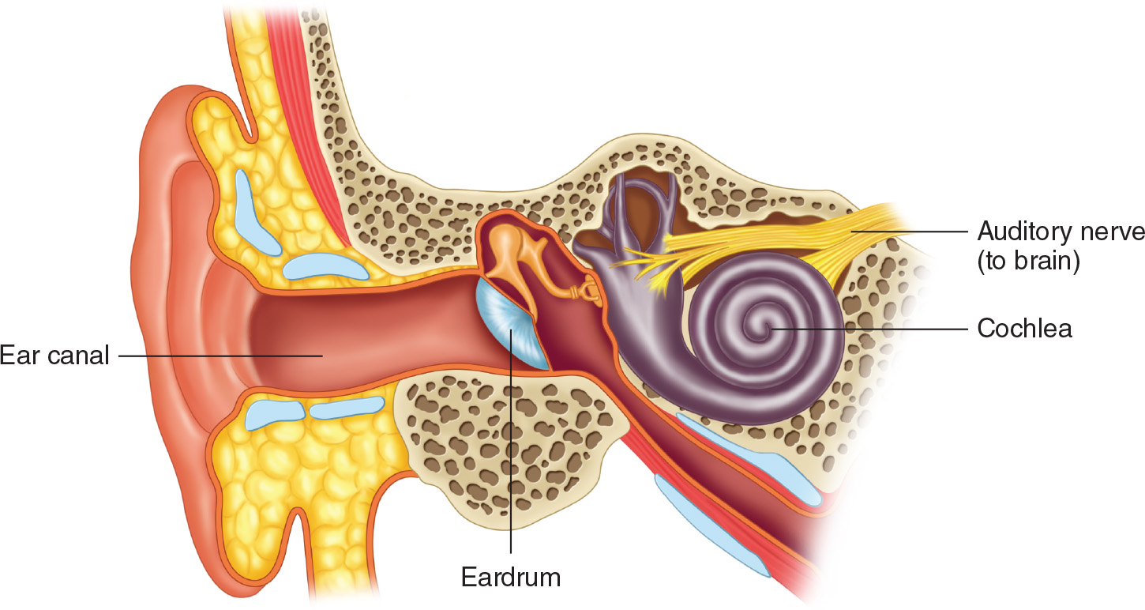
Hearing (1 of 2)
Hearing is more developed than vision at birth.
How does hearing work?
  Moving air molecules enter the ear and cause the eardrum to vibrate.
  Vibrations transmitted to the cochlea in the inner ear.
  Converted to signals that the brain interprets as sounds

Slide 24
Hearing (2 of 2)
Young infants show a preference for speech over nonspeech sounds:
  Infants 2 to 3 months old can discriminate between similar consonant sounds.
  Newborns recognize vowel sounds from their native language.
  Unborn fetuses can distinguish their mother’s voice from a stranger’s voice.
    Researchers measured fetal heart rate.

Slide 25
Speech Perception
Infants begin life biologically prepared to learn any language:
  By 1 year, largely insensitive to contrasts of sounds not made in their native language
  Over the first year, show increased sensitivity to native language sounds

Slide 26
Influences on Early Perceptual Development
Multiple sensitive periods during which vision can be influenced by experience:
  Normal development: First 3 months of life are critical.
Early exposure to auditory stimulation:
  Affects the developing brain
  Influences auditory perception skills

Slide 27
Learning to Walk: The Coupling of Perception and Action (1 of 2)
Infants acquire gross motor skills before mastering fine motor skills.
Early motor development follows the cephalocaudal principle and proximodistal principle.
It takes an average of 13 starts and stops over a period of days before toddlers show consistent performance of a motor skill.

Slide 28
Integrating Sensory Information
Senses function in an integrated way at birth:
  Newborns will look in the direction of a sound.
Cross-modal perception:
  Recognize through one sense an object as familiar through another.
  As the senses develop, toddlers become more adept at cross-modal perception.

Slide 29
Advances in Attention (1 of 2)
Attention
  Focusing of perception and cognition on something in particular
  Orienting system
    Reacts to events in the environment
  Focusing system
    Deliberately seeks out and maintains attention to events

Slide 30
Advances in Attention (2 of 2)
As children get older:
  Attention spans become longer
  Become more selective in what they attend to
  Better able to plan and carry out systematic strategies for using their senses to achieve goals
Beyond ages 8 to 9, not much increase in length of sustained attention:
  Children become more accurate on tasks requiring sustained attention.

Slide 31
More Selective Attention (1 of 2)
Selective attention:
  Deliberately concentrating on one thing while ignoring something else
  As children get older, selective attention increases.
Research suggests that performance of young children will be better if distractions are kept to a minimum.

Slide 32
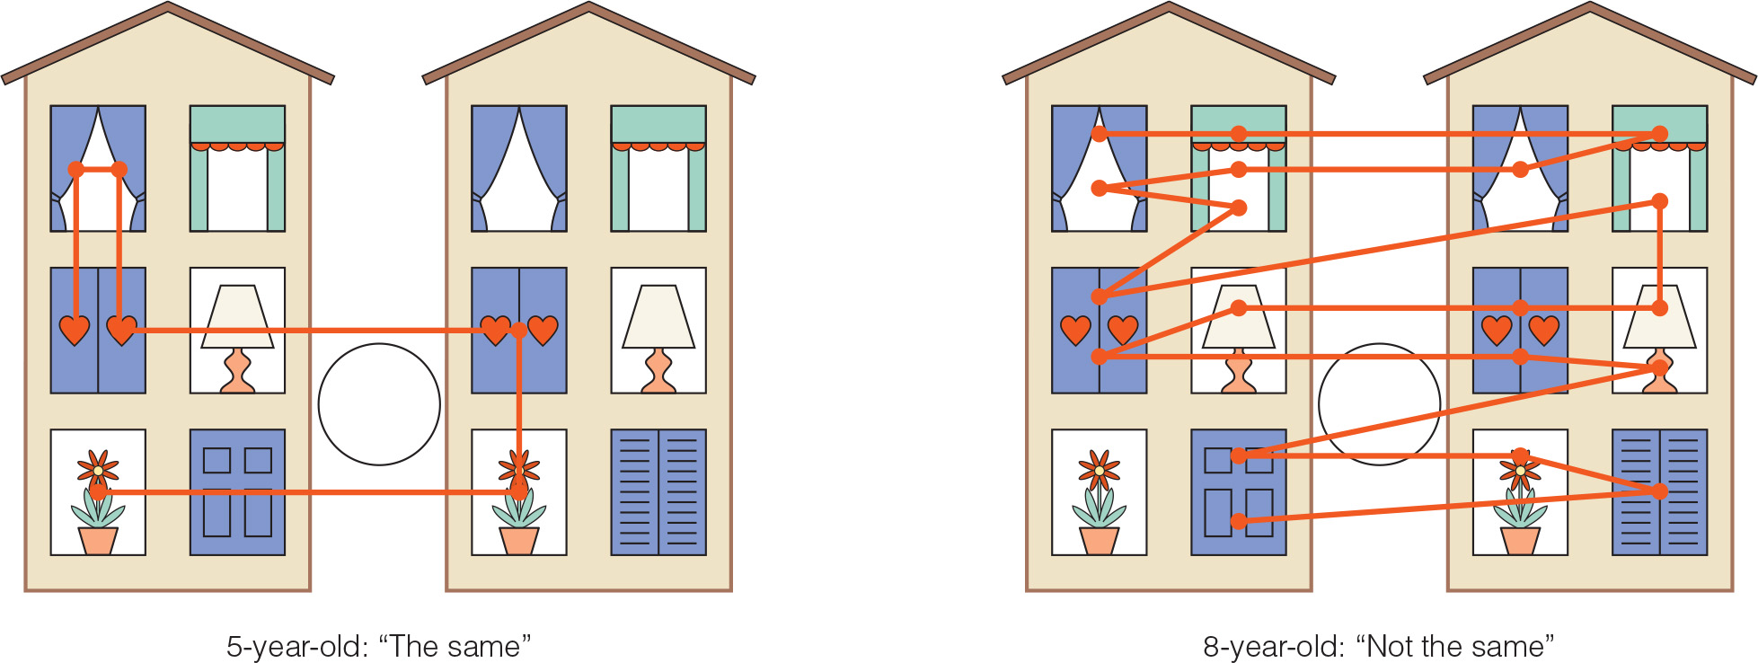
More Systematic Attention (2 of 2)

Slide 33
Attention
Adolescents have longer attention spans than children:
  Tied to increased myelination of those portions of the brain that help regulate attention
  Become more efficient at ignoring irrelevant information
  Can divide their attention more systematically between two tasks
Consequences of multitasking?

Slide 34
Sensory Changes in Adulthood
Sensory and perceptual capacities decline gradually with age because of:
  A rise in sensory threshold
    Sensitivity to very low levels of stimulation is lost.
  Declining perceptual abilities
  Difficulties in older adults in processing or interpreting sensory information
    Cognitive declines!

Slide 35
Vision and Hearing Challenges
Modern world poses some risks to maintaining healthy senses:
  Screen time
    Eye strain, headaches, blurred vision, dry eyes, difficulty focusing, and pain in neck and shoulders
Loud sounds (above 75 decibels) may lead to hearing loss.
Tinnitus—ringing sounds in the ears

Slide 36
Table 5.3 Age-Related Changes in the Visual System
Part of Eye | Age-Related Changes/Disease | Resulting Limitation(s)
Pupil | Less responsive to changes in lighting conditions and to dim light | Difficulty reading menus in dimly lit restaurants; trouble with night driving; unable to adjust quickly enough to oncoming lights at night or exiting a movie theatre into daylight
Lens | Cataract: Cloudiness of the lens Presbyopia: Thickening or hardening of the lens | Blurred or distorted vision Decreased ability to see close objects; need for “reading” glasses
Retina | Age-related macular degeneration (AMD): Photoreceptors in the middle of the retina, the macula, deteriorate Retinitis pigmentosa (RP): Deterioration of light-sensitive cells outside the macula | Loss of central vision, an important contributor to reading, driving, watching TV, and other daily activities Loss of peripheral vision
Eyeball | Glaucoma: Increased fluid pressure in the eyeball | Loss of peripheral vision and eventual loss of all vision
Notes:
Table 6.3 Age-Related Changes in Vision

Slide 37
Attention and Visual Search
What happens as we get older?
  Older adults have greatest difficulties in processing visual information when the situation is novel and when it is complex.
  Have fewer problems when there are clear expectations about what to do and when task is not overly complicated

Slide 38
Hearing Impairments
In older adults:
  Hearing impairment is three times as prevalent as visual impairment.
  A majority of individuals older than 65 have at least mildly impaired hearing.
Most age-related hearing problems:
  Due to degeneration of cochlear hair cells, surrounding structures, and the neurons leading from them to the brain
Men lose hearing sensitivity at faster rate.

Slide 39
Speech Perception (2 of 2)
Older adults typically have more difficulty understanding conversation:
  Age-related declines in auditory sensitivity
  Cognitive declines
Auditory tasks are more difficult for older adults when they are novel and complex.

Slide 40
Changes in the Other Senses
Detection threshold for touch increases and sensitivity is gradually lost from middle childhood.
Older people may be less sensitive to changes in temperature.
Age differences in pain thresholds are not large or consistent.

Slide 41
Percentages of Older Adults with Vision and Hearing Impairments Who Report Limits on Activities
Activity | With Visual Impairments | With Hearing Impairments | With Both Visual and Hearing Impairments | Without Visual or Hearing Impairments
Difficulty walking | 43.3 | 30.7 | 48.3 | 22.2
Difficulty getting outside | 28.6 | 17.3 | 32.8 | 11.9
Difficulty getting in or out of a bed or chair | 22.1 | 15.1 | 25.0 | 10.4
Difficulty taking medicines | 11.8 | 7.7 | 13.4 | 5.0
Difficulty preparing meals | 18.7 | 11.6 | 20.7 | 7.8
Notes:
Table 6.5 Percentages of Older Adults with Vision Impairments Who Report Limits on Activities

